Slide 1
Online Student Orientation

Slide 2
Our Missions
Goodwill Industries of Southeastern Louisiana, Inc. offers opportunities to people with disabilities or other barriers to improve their economic self-sufficiency through training, education, support services and employment.
Goodwill Technical College offers quality occupational education in a supportive environment that prepares students for competitive employment.

Slide 3
COVID-19 Updates
Face masks are mandatory and must always be worn within the building
Social distancing (maintaining 6 feet of physical distance) will be enforced for the safety of all students, staff and faculty
Please follow all guidelines and signs around the building
Please try to minimize the number of people in the restroom at a time
All desks are separated 6 feet apart; please do not rearrange seating

Slide 4
Faculty, Staff & Administrators
Jada Boudoin, Director of Student Affairs
James Conrad, Instructor, General Education
Triste Cosse’, Career Specialist
Shaleska Julian, Hospitality Lead Instructor
Scottie LeBlanc, Vice President of Mission Services
Eva Morgan, Administrative Assistant
Renee Gill-Pratt, Director of Engagement and Outreach
Kristel Shelton, Financial Aid/ Account Manager
Juaniece Smith, College Counselor
Vanessa Sumler, Medical Billing & Coding & Medical Office Administrative Assistant Lead Instructor
LeShay Taylor, Enrollment Manager
Kiedra Williams, Chief Academic Officer

Slide 5
Student IDs
EXAMPLE
Student ID pictures will be taken the first day/week of the semester by a college staff member
Student IDs will only grant you access to certain areas of the building during certain times
Student IDs must always be worn while on campus
Students may use IDs to enter the building through the parking garage walk-in gate

Slide 6
Student Parking
Student parking is available behind the building and against the side of the GTC building in Liberty Bank’s parking lot.
Students are prohibited from parking in the parking garage under the building and in any other parking spaces in Liberty Bank parking lot.
Please ensure if you request a parking pass that is it visible in the front windshield of your car.

Slide 7
Programs
Medical Billing & Coding (MBC)
Medical Office Administrative Assistant (MOAA)
Skills, Tasks and Results Training (START)

Slide 8
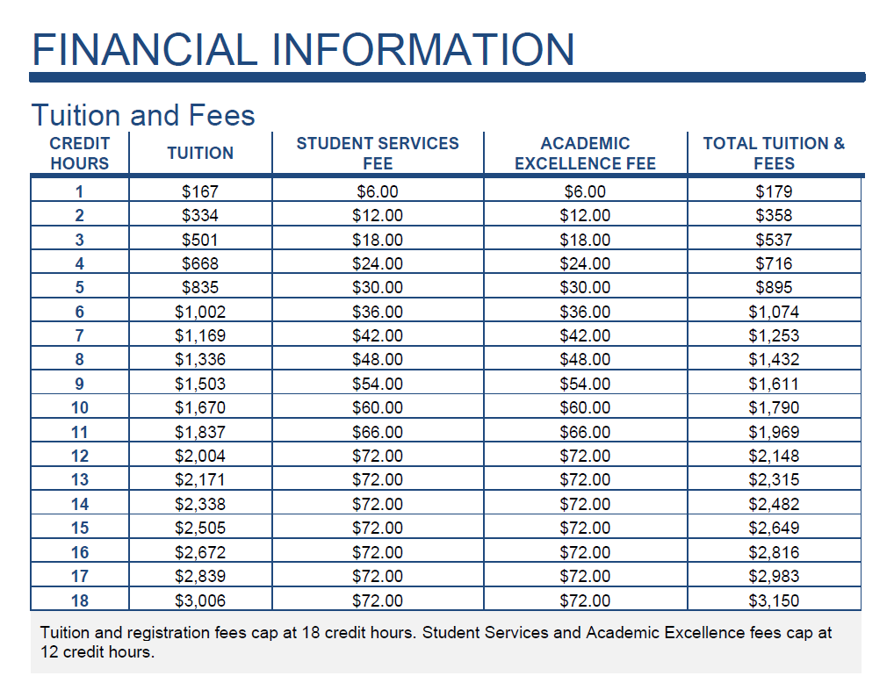
Tuition and Fees Academic Excellence Fee: The academic excellence fee promotes academic excellence at the College by enhancing institutional programs. The fee is charged at $6 per credit hour, not to exceed $72. Student Services Fee: The student services fee covers services that benefit the student and are complementary to, but not part of, instructional programs. The fee is currently charged at $6 per credit hour. Not to exceed $72 per semester.

Slide 9
Policy Overview
College Catalog
Student Handbook

Slide 10
Academic POLICIES
Academic Calendar
Refunds Policy
Drop/Add Policy
Academic Appeals
Notes:
Handout

Slide 11
Student affairs policies
Student Code of Conduct
Academic Honesty
Appearance and Attendance
Disciplinary Appeals
Student Grievance Policy
Records Policy
Career Services

Slide 12
Student Technology
Campus Café
(Student Information System)
Canvas
Cengage

Slide 13
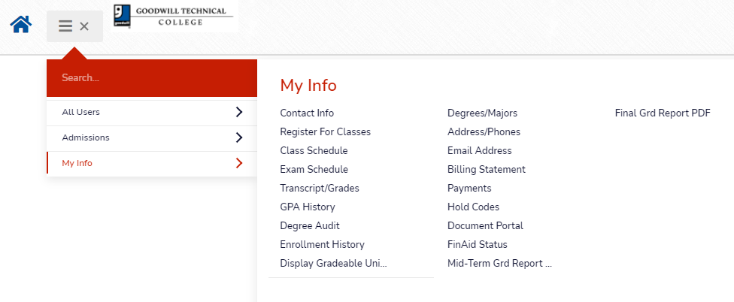
Campus Café’ (Student Information System)
Your login was provided via email when you applied to the college
Once logged into the portal you can register for courses, view class schedule & grades, make payments, view fee bill, view degree audit, unofficial transcript, & many more options.
Click the link below to login to the portal:
https://gwl-web.scansoftware.com/cafeweb/login

Slide 14
CANVAS
Your instructor will send a link to the email address on file inviting you to join the Canvas course you are enrolled in.
Click the link and follow the instructions.
View the video below for an overview of Canvas. Your instructor will provide more details in class.
https://www.youtube.com/watch?v=AXAAt5IATVI

Slide 15
Cengage
Cengage allows access to the electronic format of majority of the books used in the classroom.
A keyless code option is live within Canvas.
Please note that some of the books are not on Cengage. It will be the responsible of the student to purchase books not covered under the key code.
A book list will be emailed with specifics prior to the semester beginning.
https://www.cengage.com/coursepages/Goodwill_Tech_Cengage_Student_Resources

Slide 16
Job Placement Form
Please complete the attached form via JotForm if you are currently working.
https://form.jotform.com/212785888153065

Slide 17
Accredited by: Council On Occupational Education
Goodwill Technical College (GTC)
Is accredited by the Commission of the Council on Occupational Education and is entitled to the recognition and privileges resulting therefrom. The accreditation denotes that an institution has undergone an extensive self-study and team review process and has been judged by the Commission as meeting its Standards and Conditions for accreditation.
Why is this important?: Accreditation is a status granted to an educational institution or program that has been found to meet or exceed stated criteria of educational quality and student achievement. Accreditation by COE is viewed as a nationally-honored seal of excellence for occupational education institutions such as Goodwill Technical College and denotes honesty and integrity. Accreditation ensures academic quality. Additionally, being accredited by COE allows credit you’ve earned at GTC to be transferable to other COE accredited institutions.

Slide 18
Next Steps
Please complete the orientation quiz under New Student Orientation.
https://form.jotform.com/202244232215137
Thank you for choosing Goodwill Technical College.

